Slide 1
Topic Comparison for Personalized Research Evaluation
Angela Zhang
Under the direction of Dr. Christopher Healey
Committee: Dr. James Lester, Dr. Jung-Eun Kim, and Dr. Rada Chirkova

Slide 2
Motivation
Evaluating quality of a potential submission is hard for someone less experienced
That difficulty can apply to most researchers: applying to less familiar venues, developing new research focus, or changing research focus
Evolving “relevant” research priorities from top conferences require constant learning of topic landscape (e.g., “LLM-related” research papers grew from 503 in 2019 to 7109 in 2024)Xia, Et al.
Actionable insight are not always provided from conferenced reviewed peer feedback, even after extended waiting periods
Automated topic evaluation for author research landscape would enable better decision making in selecting venues, adjusting research framework, and prioritizing conference deadlines
Xia, Et al. “Analyzing 16,193 LLM Papers for Fun and Profits.”
Notes:
You would evaluate typically based on competing works discovered through a literature review.

Slide 3
Manual Literature Review
Common Challenges
Time Consuming: May have to read through thousands of abstracts
Scan Limited: Manually identify relevant papers from titles, authors or keywords
Existing tools like Google Scholar can hide relevant areas from newer authors while showing more cited works that are not relevant
ConnectedPapers.com try to overcome this but are still limited to citation graphs
Keywords on same research can change overtime, limiting search to specific time periods (i.e. transformers -> pre-trained language models)
No quantitative measure literature review accuracy

Slide 4
Limitations of Literature Diversity
Current tools such as Google Scholar and ConnectedPapers.com can limit diversity by excluding:
Emerging topics (e.g., “Reasoning”, “Chain of Thought”)
Newer or less popular authors with relevant and solid research
Less mainstream topics that have similar solutions
Notes:
Let’s take a look at another way we can approach this problem through topic modelling.

Slide 5

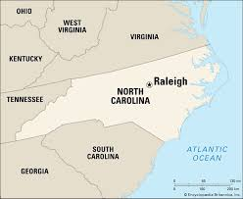
Topic Coverage Impact
Local topic coverage of solutions to same/ similar RQs
Global topic coverage to understand areas of relevance and impact

Slide 6
Topic Coverage Impact
Resolve some key terms nuance that combine:
Similar research across key term groups from different time periods
Unique key terms with a common identifying topic
Provides context for and filters mass group of literature for specific topic criteria
Semantic retrieval tools for literature review are emerging, but they often do not provide topic modelling.
Notes:
Instead of using individual keywords, topics can provide semantic context across groups. –End: Given the importance of topic modelling for determining publication readiness, we will address implementation challenges through our research goals.

Slide 7
Research Goal
To the best of our knowledge, this work is the first to connect both automated literature scan and peer review
The goal is to offer concise, qualitative data to assist in the subjective decision-making of publication readiness
  Topic novelty and completeness
  LLM reasoned suggestions of topic relationships to user abstract
  Optimize human and AI collaboration in decision making

Slide 8
Background Table of Contents
Automated Literature and Peer Reviews
Domain Text Challenges
Dimension Reduction
Clustering
Jaccard Similarity and Jaccard Undersampling
Topic Modelling
LLM Reasoning Models

Slide 9
Automated Literature Reviews
LLMs have been studied for literature scan automations such as below:
Organizing literature into hierarchies
Scanning bulk literature for inclusion/ exclusion
  Specified topics/ key terms/ phrases
  Scoping against summary of specified criteria
  LLM assisted topic/ key term mining of abstract ideas (e.g., “pain”)
Full or partial authorship of literature surveys

Slide 10
Automated Peer Reviews
LLMs have been studied for peer review automations such as below:
Polite communication and feedback
Structured arguments to improve writing organization
Assessing novelty
Limitation:
“ChatGPT might struggle with in-depth comprehension and contextual understanding of highly specialized or nuanced scientific topics.” Biswas, Et al.
Biswas, S. et al. “ChatGPT and the Future of Journal Reviews: A Feasibility Study”.

Slide 11
Sentence Embedding
LLM Sentence Embeddings are used for all clustering experiments
paraphrase-MiniLM-L6-v2 - a sentence embedding transformer-based model
Outputs a semantic representation of a sentence as an embedding vector of 384 dimensions
Mean-pool: continuous similarity score is averaged across terms
Limitations: Semantic context for individual terms may get diluted for longer sentences
Notes:
For our clustering experiments, we use a sentence embedding model. Go through this slide. Though this is a high performer for most general text cases, there can be additional domain text challenges.

Slide 12
Domain Text Challenges
Domain specific text, especially in scientific publications, may be limiting in the following:
Vocabulary is not part of LLM training data
May be missed for LLMs that rely on text frequency
Can result in LLM excluding domain vocabulary during summarization, concept interpretation, etc.
Data sparsity and outlier challenges

Slide 13
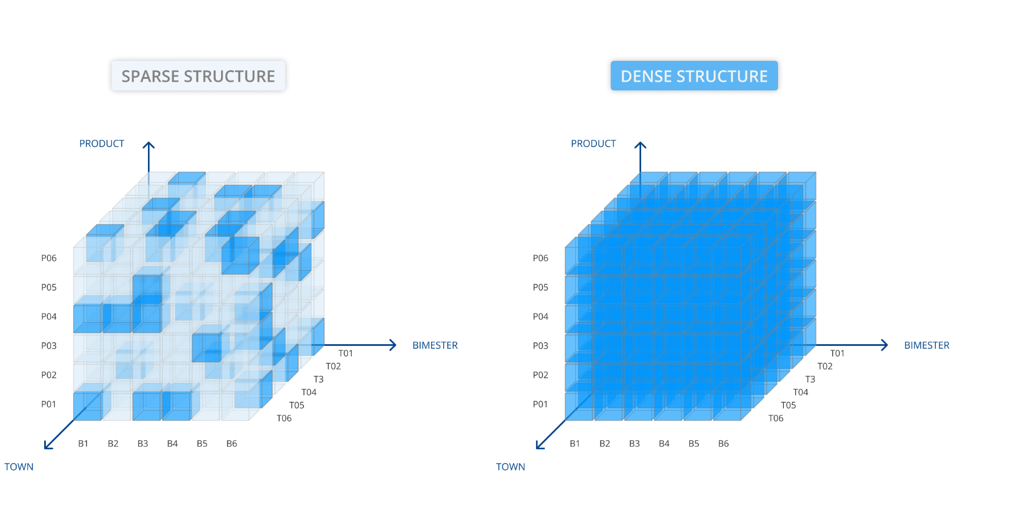
Data Sparsity and Outlier Causes
Clustering with data sparsity results in outliers because there are little common dimensions amongst other documents
Notes:
Text to Vector transformation is often some form of a matrix of word or phrase(n-gram) frequency
Less frequent terms result in a matrix with many zeros
This results in data sparsity (e.g., sparse matrix)
Document outliers are unique data points that typically can not be semantically grouped

Slide 14
Data Sparsity and Outlier Challenges
The following can result in data sparsity:
Specialized terms are less likely to appear across multiple abstracts
Novelty criteria may encourage unique descriptions
Abstracts typically contain less, general supporting statements
Context overfitting in embedding models (e.g., bias of training data for specific domains)
This limits clustering and results in high outliers!

Slide 15
Dimension Reduction
Embedding vectors can contain 300+ dimensions
Lower dimension to enable clustering
Linear transformations - compact dimensions through linear separations
Non Linear transformation - typically through manifold learning (e.g., curves, folds, etc.)

Slide 16
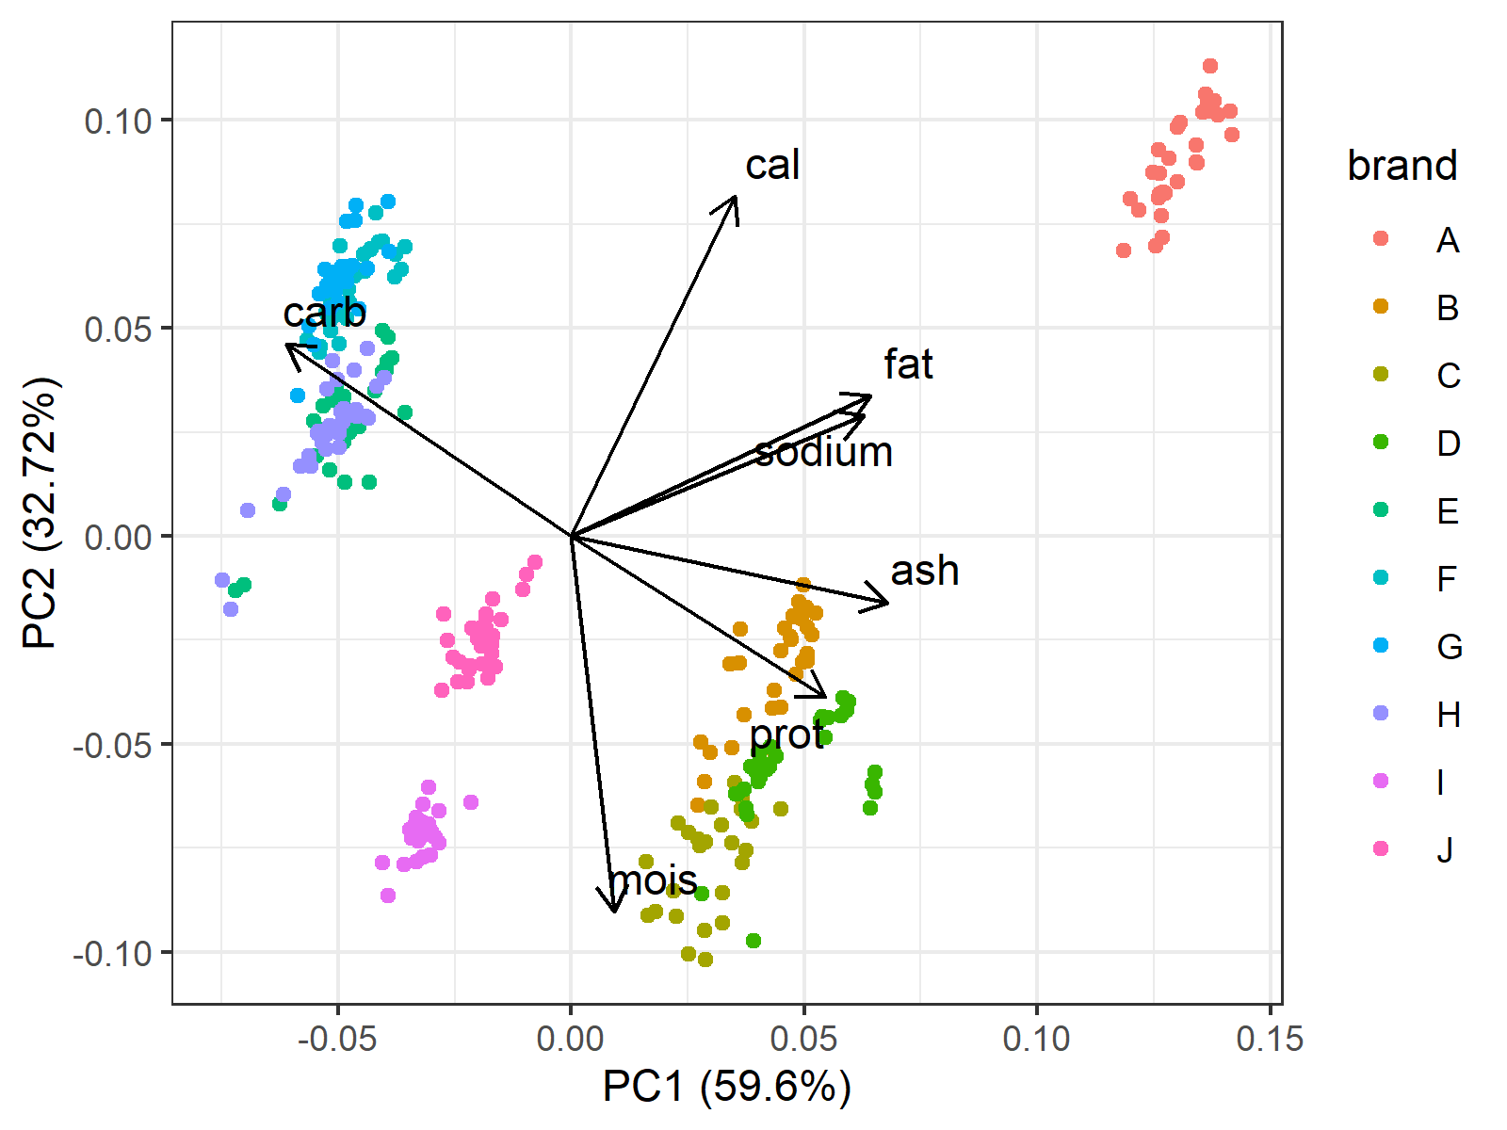
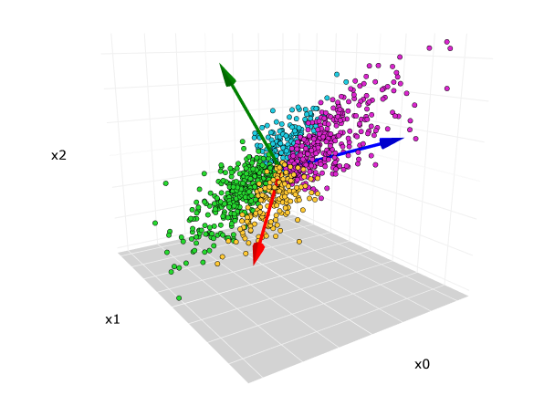
Principal Component Analysis (PCA)
Reduced orthogonal axes that retain required amount of variance in original data space
Goal is to minimize dimensions while maintaining data pattern of original data space

Slide 17
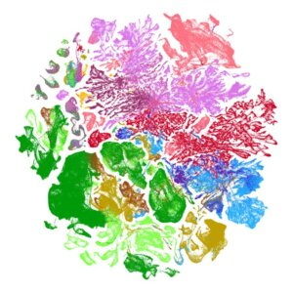

Uniform Manifold Approximation and Projection (UMAP)
Based on manifold learning, UMAP converts distances into probability similarities of neighborhood likeliness, that is, how likely another point is to be a neighbor.
Notes:
UMAP is based upon manifold learning, which means instead of a flat plane, it observes points on
a lower dimension, curved manifold structure (e.g., a geometric representation of neighborhood
pairwise distances) [McI18]. It then creates a low-dimensional plane using these local manifold
approximations. The final topic graph is optimized by minimizing the cross entropy loss between
the original structure and lower-dimension plane.

Slide 18
Clustering
K-MEANS - Centroid based, will not separate outliers
DBSCAN - Sensitive to outliers, based on uniform euclidean distance, less able to conform to data variance
HDBSCAN - Extends DBSCAN by using relationship probabilities to capture data variance (e.g., varying popularity across different subtopics)

Slide 19
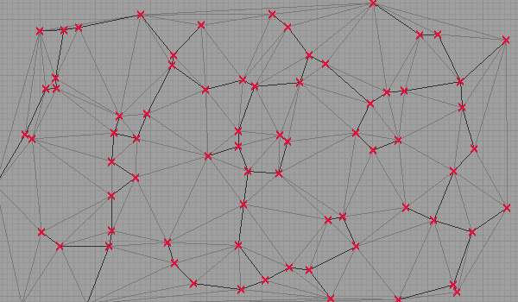
Hierarchical DBSCAN Clustering
Hierarchical Density-Based Spatial Clustering of Applications with Noise
Extends DBSCAN by clustering with varying densities
Builds minimum spanning tree with mutual reachability distance
Prune large distance edges (i.e., remove excess mass)
Extract clusters based on minPts
May form global clusters
Notes:
A significant portion of the data can result in global clusters if there are not strong local relationships. Even though these global clusters can contain multiple subtopics, we would still like to be able to use them. Thus, we will Jaccard Similarity in an effort to better optimize these clusters.

Slide 20
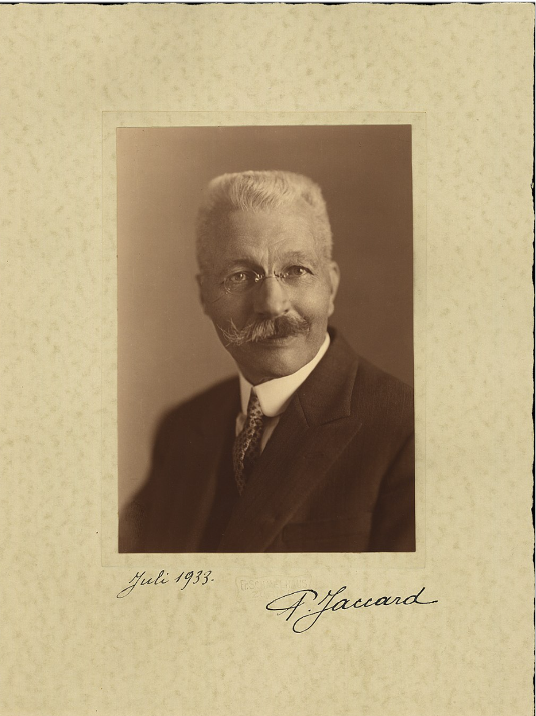
Jaccard Similarity
Developed by Paul Jaccard in 1901
Measures the similarity of items between two sets
J(A,B) =|A ∩ B| / |A ∪ B|
Set intersection of A and B / Set Union of A and B
Range - always be between 0 and 1
higher Jaccard values indicating higher similarities
Binary consideration of whether the term is or is not in the document
Commonly used to find duplicate documents or key-word overlap
From 890 Written Preliminary
Notes:
Slide from 890 presentation
Measures overlap between two sets
Ratio of similar words to total unique words.

Slide 21
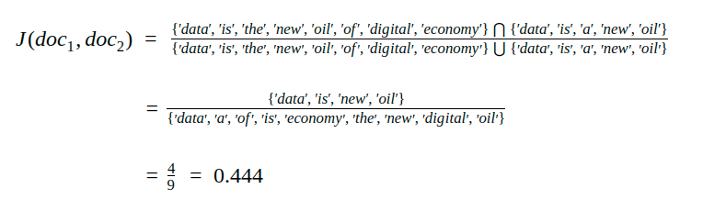
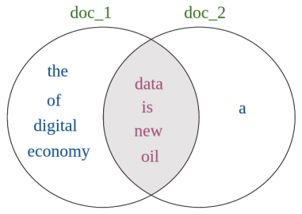
Jaccard Similarity Text Example
Measures overlap between two sets, equivalent to overlapping words/ total unique words
Credit: https://studymachinelearning.com/jaccard-similarity-text-similarity-metric-in-nlp/
From 890 Written Preliminary

Slide 22
Topic Modelling
Extracting common themes or topics
Probabilistic Topic Modelling:
  Latent Dirichlet Allocation (LDA)
  Latent Semantic Analysis (LSA)
c-TF-IDF + LLM embeddings: BERTopic
Zero-shot LLM prompting

Slide 23
Latent Dirichlet Allocation
Applied as an unsupervised topic modelling approach
Generative probabilistic model that discovers latent topics within a collection of documents
Each document is represented as a mixture of topics
Probabilistic topic models typically perform well with more well-structured data sets (e.g. repetitive news articles)
Potential Limitation: May not be suitable for shorter documents as variance inference is limited

Slide 24
BERTopic Topic Modelling for Clusters
BERTopic is a topic modeling algorithm that uses LLM word embeddings (BERT) and TF-IDF to form clusters
  UMAP is applied for dimension reduction and HDBSCAN is used for clustering
  Original text is transformed into a c-TF-IDF matrix representing an entire cluster as one document
  The highest-scoring keywords are then used to define “topics”

